Slide 1
System dynamics workshop: the vaccine
Modelling Systems
CM2014 Spring 2025

Slide 2
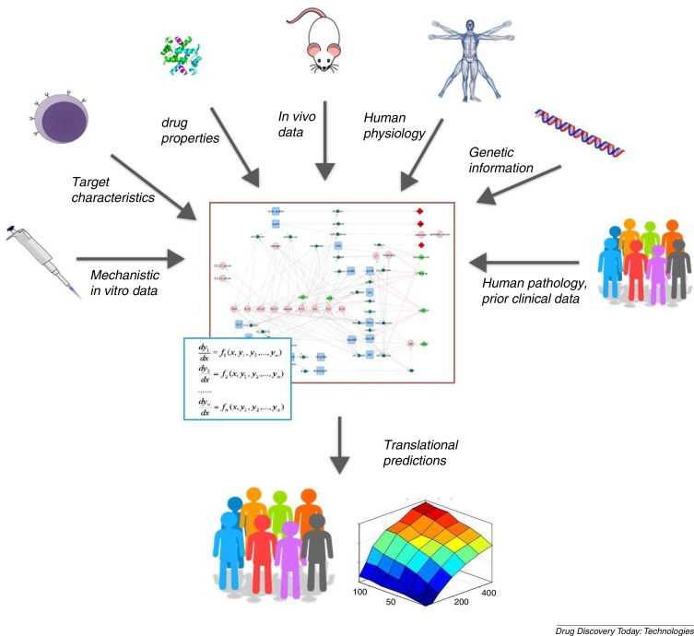
Quantitative Systems Pharmacology – System dynamic modelling
system dynamic
modelling & simulation
Gadkar et al. 2016

Slide 3
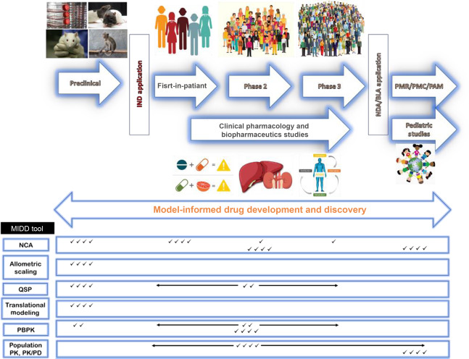
Modelling in drug and vaccine research & development
Elmeliegy & Ghobrial 2021

Slide 4
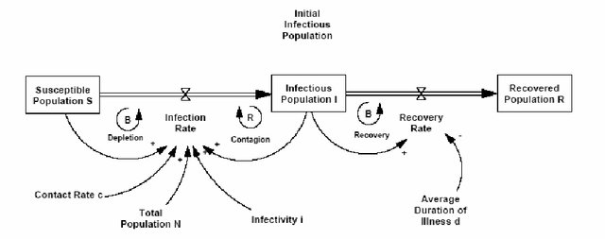
The workshop
Aim and objectives:
Training on development of conceptual models based on problem description.
Reflect on real-world use cases and how models can integrate large amounts of information.
Saleh & Davidsen 2007

Slide 5


Some basic nomenclature of causal loop diagrams and stock-and-flows models
access
to
nutrients
+
reinforcing
feedback
loop (R)
R
Variables,
causal links,
polarity
growth
+
-
food
hunger
balancing
feedback
loop (B)
B
+
-
delay
order
stock
Stocks,
flows, sources
and sinks
stock over time
A
population
inflow
outflow
stock
causal loops
+
B
E
+
births
for
example:
C
D

Slide 6
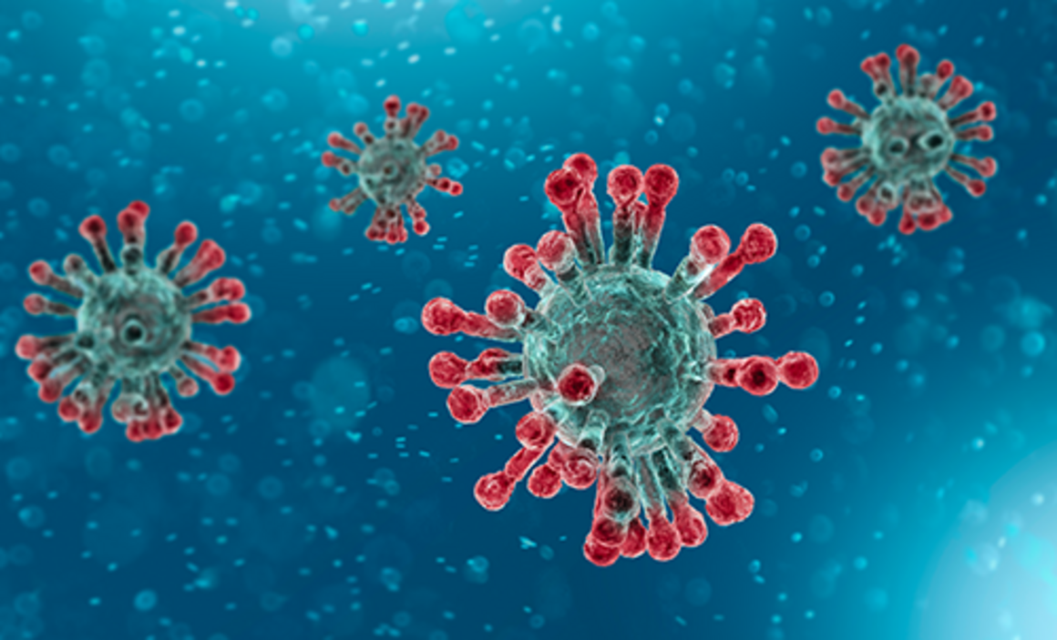

Slide 7

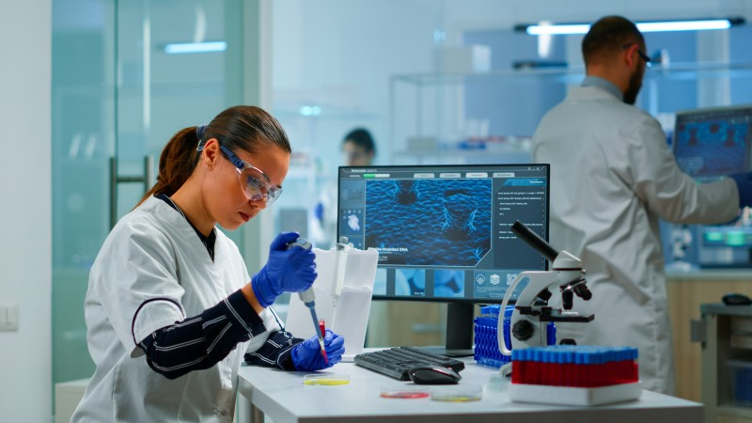

Slide 8





disease model
+
teams of
up to eight
discuss your
findings
work on the combined
model together
pharmacological
model (choice of
two therapies)
short reflection/feedback
together

Slide 9
Model A: disease model
Problem statement: Considering the mechanism of SARS-CoV-2, what are the potential drug/vaccine targets?
Task: Based on the available information, develop a conceptual SARS-CoV-2 disease model (causal loop diagram/stocks-and-flows).
Question 1: Given the structure of the model, what can we say about the above question?
Question 2: Does the model explain the emergence of severe disease?
Question 3: How and why would we want to translate this into a quantitative simulation model?

Slide 10
Model A: Disease mechanism - immuno-response model
Data Table. Disease mechanism of immuno-response.
SARS-CoV-2 infection leads to increase in systemic blood viral load. Systemic blood viral load leads to infection of susceptible cells: SARS-CoV2 spike (S) proteins adhere to the membrane of cells (ACE-2 receptors) and fuse with the membrane. Viral RNA is translated into viral proteins in the rhibosomes. This includes RNA-dependent RNA polymerase, that produces more viral RNA. Viral proteins form new viruses that can exit the cells. RNA is degraded in the cytoplasm. Infection of susceptible (alveolar) cells leads to increased viral load. Infection of susceptible cells leads to increase in pro-inflammation signaling (innate and adaptive immuno response – antibodies to recognise antigens). Infection of susceptible cells leads to increase in tissue damage. Tissue damage increases pro-inflammation. Free viral load leads to increase in pro-inflammation signaling. Pro-inflammation signaling reduces viral load. Pro-inflammation signaling reduces infection of susceptible cells. Pro-inflammation signaling increases tissue damage through induced cell death. Pro-inflammation signaling increases anti-inflammatory signaling (T-cells, interleukins, TGF-Beta). Anti-inflammatory signaling reduces pro-inflammatory signaling.

Slide 11
Model B: pharmacological model
Problem statement: considering the pharmacological effect of infectisivir®/ Modern Phaser® vaccine. What formulation (drug delivery) effects and patient characterstics should be considered?
Task: Based on the available information, develop a conceptual pharmacological model (causal loop diagram/stocks-and-flows).
Question 1: Given the structure of the model, what can we say about the above question?
Question 2: Are there any missing aspects in the data/model?
Question 2: Why would we want to translate this into a quantitative simulation model? How? (what technique)

Slide 12
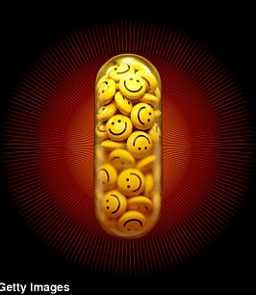
Model B(i): pharmacological model - infectisivir
Data Table. Pharmacological mechanism of the infectisivir drug therapy.
About the drug: Infectisivir is an adenosine nucleotide analogue prodrug that is metabolically activated to GS-44992. The compound acts to reduce SARS-CoV-2 viral load. Drug disposition: Infectisivir is administered to a person as an intravenous injection into systemic blood. From systemic blood, Infectisivir is distributed into peripheral tissues and back into blood. Infectisivir is distributed to the liver through blood flow and is metabolised by enzymes into GS-44992. GS-44992 will is distributed back to systemic blood from the liver and into (and back from) peripheral tissues. GS-44992 is eliminated from the kidneys into urine through passive filtration. Mechanism of action: Inside SARS-CoV2 infected cells, GS-44992 binds to RNA-dependent RNA polymerase RDRP - a SARS-CoV-2 protein that produces more SARS-CoV-2 viral RNA (encoded in SARS-CoV2 and produced by the rhibosomes in human cells). GS-44992 interferes with RDRP RNA production by acting as a adenine analogue, this eventually stops the production of viral RNA through RDRP. As a counteracting effect, the viral protein exoribonuclease detects and fixes errors in viral RNA. Infectisivir then reduces viral RNA and improves lung function.

Slide 13

Model B(ii) – The “Modern Phaser” Vaccine
Data Table. Pharmacological mechanism of the Modern Phaser Vaccine.
About the vaccine: The “Modern Phaser” vaccine contains strands of RNA encoding for a SARS-CoV2 antigen, encased in lipid nanoparticles (LNP) to avoid elimination by the human immunesystem. Vaccine disposition: The vaccine is administered by intramuscular injection. LNPs are distributed into the central blood flow, and from central blood flow. LNPs are distributed from central blood into peripheral tissues, and back again. LNPs can distribute into cells across the cellular membrane. LNPs degrade over time in the body. Mechanism of action: LNPs release mRNA for producing spike proteins of SARS-CoV-2 (antigen), making use of the cellular functions for protein production. mRNA is degraded in the cytoplasm. Spike proteins are present on cell membrane. The spike proteins trigger an immune response. The innate immune system attempts to eliminate infected cells. Over a longer duration of time, the adaptive immune systems builds up memory cells (antibodies) for recognising and eliminating SARS-CoV-2.

Slide 14
Model A&B: The combined model
In the larger group, discuss how these models could be combined and where the links would be in the respective models.
What is the added value of a combined model?
What are the disadvantages?
And finally, what is the added value of a systems modeller (e.g., medical engineer) in pharmaceutical development?

